Slide 1

Software Engineering Best Practices Why, What and How
Michael A. Heroux Senior Scientist, Sandia National Laboratories Scientist in Residence, St. John’s University, MN
So your code will see the future.

Slide 2
Acknowledgments
This work was supported by the U.S. Department of Energy Office of Science, Office of Advanced Scientific Computing Research (ASCR), and by the Exascale Computing Project (17-SC-20-SC), a collaborative effort of the U.S. Department of Energy Office of Science and the National Nuclear Security Administration.
Sandia National Laboratories is a multimission laboratory managed and operated by National Technology and Engineering Solutions of Sandia, LLC, a wholly owned subsidiary of Honeywell International, Inc., for the U.S. Department of Energy’s National Nuclear Security Administration under contract DE-NA0003525.

Slide 3
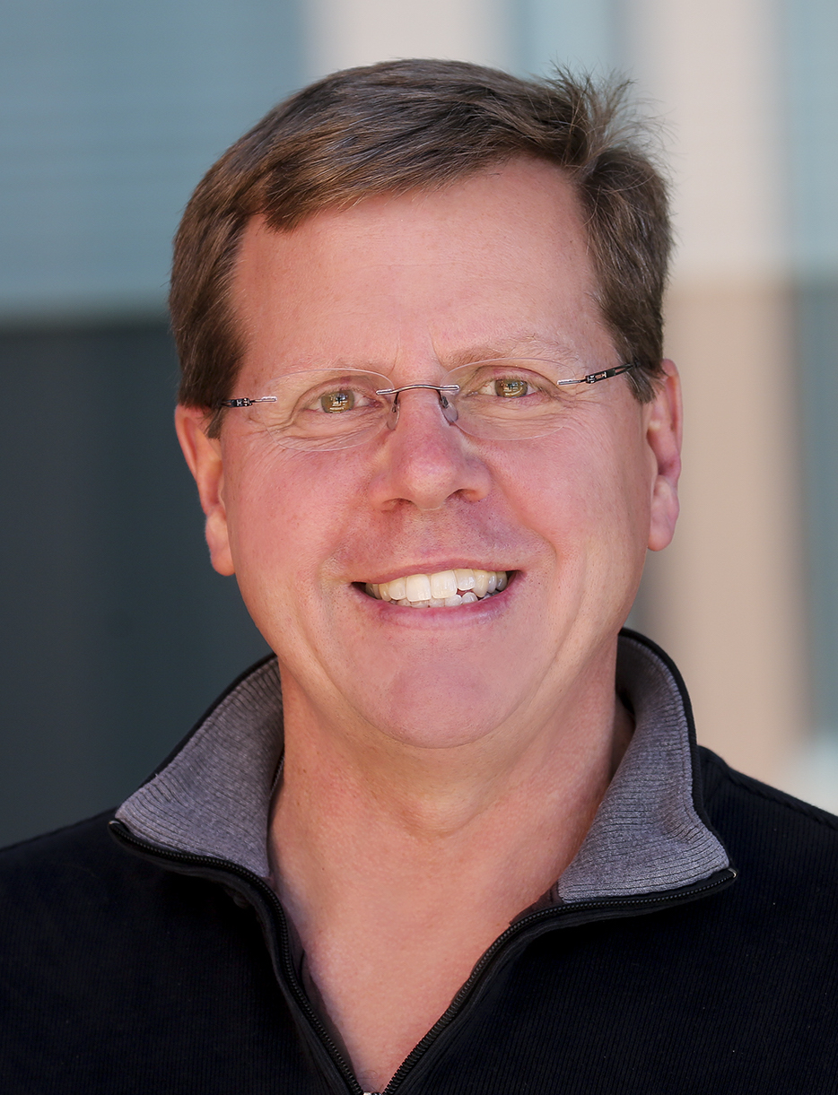


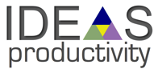


My Background
1998 – now: Staff member at Sandia National Labs
Lead these projects:
ECP SW Technology since Nov 2017.
Trilinos: collection of scientific libraries – trilinos.github.io.
Mantevo: “Miniapps” project for HPC co-design – mantevo.github.io
IDEAS Productivity: Scientific Productivity and sustainability – ideas-productivity.org
HPCG Benchmark: Complementary benchmark for Top 500 – hpcg-benchmark.org
Better Scientific Software: Portal and content for productivity and sustainability – bssw.io
SC18 Reproducibility Chair, SC19 special role
Concurrent: Scientist in Residence, St. John’s University, MN USA
1988 – 1998: Staff member at Cray Research
88 – 93: Math libraries developer, sparse solvers, LAPACK, BLAS: LIBSCI
93 – 95: Application analyst, computational engineering group: FIDAP, Fluent, Star-CD.
95 – 98: Scalable systems applications specialist: Cray T3E “MPP”.

Slide 4

Outline
My perspective.
Why we increasingly care about better software practices.
Barely-sufficient software engineering.
Lightweight small team management.
Agile methodology and scientific software.
Planning: An opportunity for improvement for scientific SW.
Two practical techniques: Stories, lightweight design docs.
How to introduce better practices.
Appealing to the best in each of us: Personal expectations.
Notes:
Motivation for verification and testing
Definitions
Best practices
Automated test harnesses

Slide 5
My Perspective
Regarding observations on opportunities to improve:
More like a scarred veteran than expert.
Regarding software tools, processes, practices improvements:
More like a carpenter than expert.
Michael Heroux 2017 DOE CSGF Meeting

Slide 6
Transparency & Reproducibility
Why we pursue better software practices

Slide 7
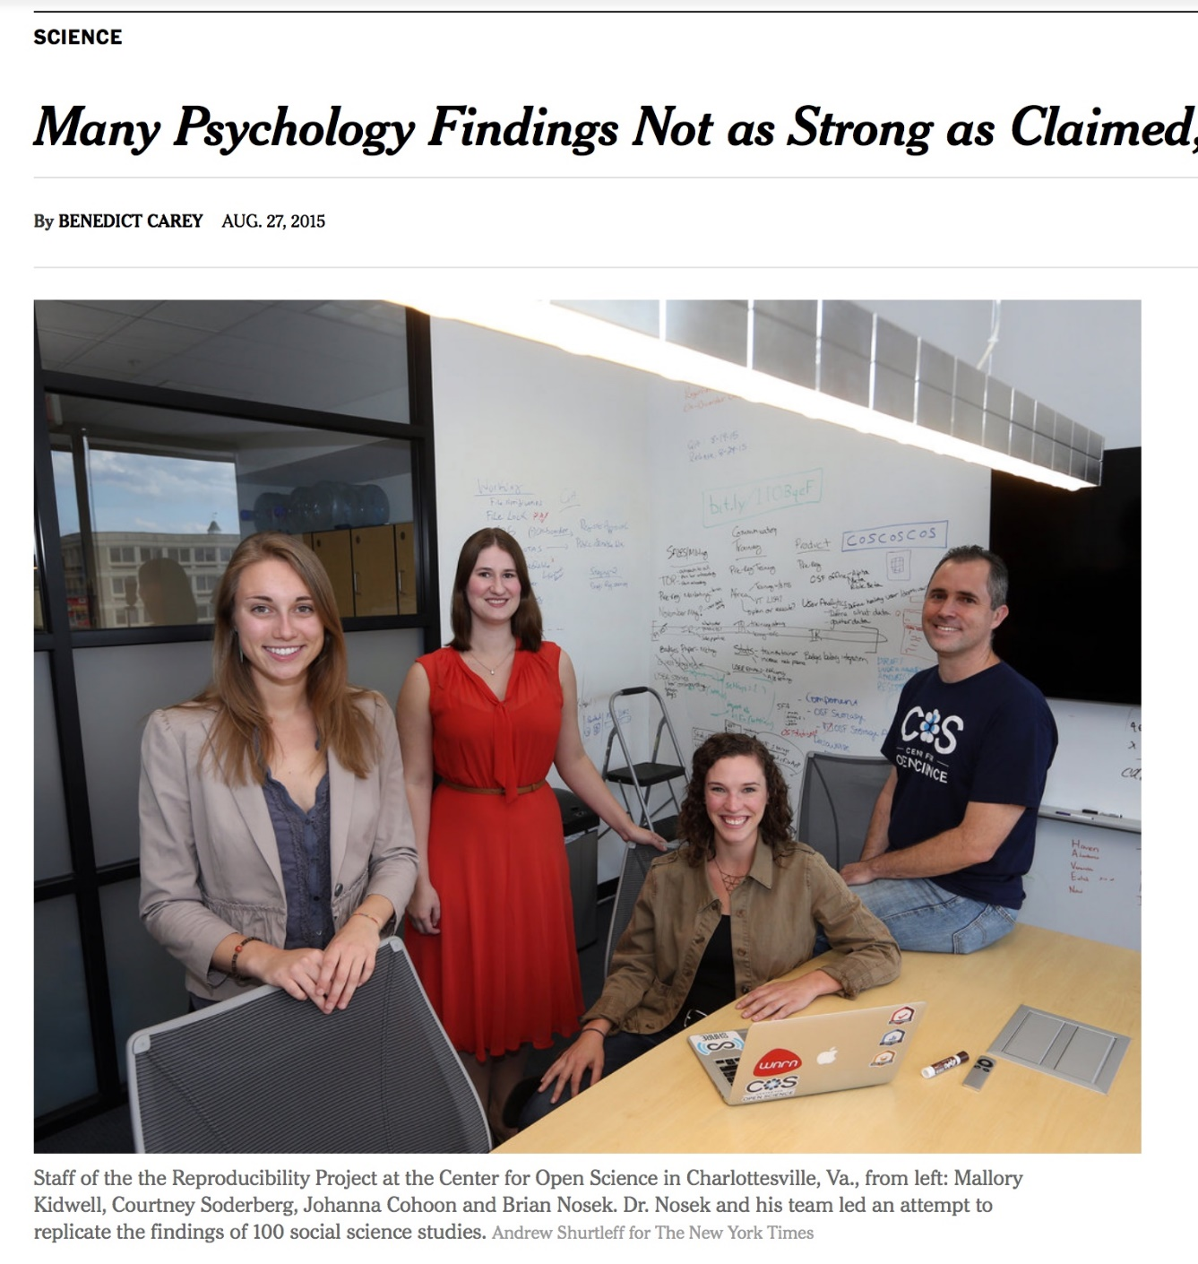
Transparency & Reproducibility
NY Times highlights “problems”.
Only one of many cited examples.
Computational science had been spared this “spotlight”.
http://www.nytimes.com/2015/08/28/science/many-social-science-findings-not-as-strong-as-claimed-study-says.html

Slide 8
Computational Science Example
Behavior of pure water just above homogeneous nucleation temperature (~ - 40 C/F).
Debenedetti/Princeton (2009):
2 possible phases: High or low density.
Chandler/Berkeley (2011):
Only 1 phase: High density.
No sharing of details across teams until 2016:
Chandler in Nature: “LAMMPS codes used in refs 5 and 12 are standard and documented, with scripts freely available upon request.”
Debenedetti with colleague Palmer: ”Send us your code.”
Received code after requests and appeal to Nature.
Source: https://physicstoday.scitation.org/do/10.1063/PT.6.1.20180822a/full/

Slide 9
Computational Science Example
Palmer located bug/feature in Berkeley code.
Used to speed up LAMMPS execution.
Replaced with more standard approach.
Obtained result similar to Debenedetti 2009.
Resolution took 7 years.
Source: https://physicstoday.scitation.org/do/10.1063/PT.6.1.20180822a/full/
For Palmer, the ordeal exemplifies the importance of transparency in scientific research, an issue that has recently drawn heightened attention in the science community. “One of the real travesties,” he says, is that “there’s no way you could have reproduced [the Berkeley team’s] algorithm—the way they had implemented their code—from reading their paper.” Presumably, he adds, “if this had been disclosed, this saga might not have gone on for seven years.”

Slide 10
Publication Trends
Increased Emphasis on Transparency & Reproducibility

Slide 11

ACM TOMS Reproducible Computational Results (RCR)
Submission: Optional RCR option.
Standard reviewer assignment: Nothing changes.
RCR reviewer assignment:
Concurrent with standard reviews.
As early as possible in review process.
Known to and works with authors during the RCR process.
RCR process:
Multi-faceted approach, Bottom line: Trust the reviewer.
Publication:
Reproducible Computational Results Designation.
The RCR referee acknowledged.
Review report appears with published manuscript.

Slide 12
SC18 Reproducibility Initiative
Two appendices:
Artifact description (AD).
Blue print for setting up your computational experiment.
Makes it easier to rerun computations in future.
AD appendix will be mandatory for SC19 paper submissions.
Artifact Evaluation (AE).
Targets ”boutique” environments.
Improves trustworthiness when re-running hard, impossible.
Details:
https://sc19.supercomputing.org/submit/reproducibility-initiative/

Slide 13
Improving Trustworthiness at Scale
What if we can’t re-run a computational experiment?

Slide 14
Reproducibility and Supercomputing
Scenario: You compute a “hero” calculation using 5M core-hours on Mira and submit your results for publication. During the review process, a referee questions the validity of your results. What options are feasible:
The reviewer re-runs your code on a laptop or cluster.
The reviewer re-runs your code on Mira.
You re-run your code on Mira.
Your results are rejected.
Your results are accepted, but with risk.

Slide 15
Sources for meta-computations
Synthetic operators with known:
Spectrum (Huge diagonals).
Rank (by constructions).
Invariant subspaces:
Example: Positional/rotational invariance (structures).
Conservation principles:
Example: Flux through a finite volume.
General:
Pre-conditions, post-conditions, invariants.
Can you think of something for your problems?

Slide 16
Example: HPCG Benchmark
Symmetry:
For any linear operator A, x^{T}Ay = y^{T}A^{T}x.
If A symmetric A = A^{T}, so x^{T}Ay = y^{T}Ax.
And x^{T}Ay - y^{T}Ax = 0.
HPCG computes the above expression for:
User matrix and the preconditioner.
Numerical detail: Need to scale by vector & matrix norms.

Slide 17
Coming to Your World Soon: Reproducibility Requirements
These conferences have artifact evaluation appendices:
CGO, PPoPP, PACT, RTSS and SC.
http://fursin.net/reproducibility.html
ACM Replicated Reproducible Computational Results (RCR).
ACM TOMS, TOMACS.
http://toms.acm.org/replicated-computational-results.cfm
ACM Badging.
https://www.acm.org/publications/policies/artifact-review-badging
NISO Committee on Reproducibility and Badging.
https://www.niso.org/niso-io/2019/01/new-niso-project-badging-scheme-reproducibility-computational-and-computing
Publishers: ACM, IEEE, figshare, STM, Reed Elsevier, Springer Nature

Slide 18
Questions, comments?

Slide 19
Better Productivity and Sustainability
Essential for affordable reproducibility

Slide 20
Incentives Demand Investments, Enabled by Investments
Demand
Transparency & Reproducibility Requirements
Productivity & Sustainability Investments
Enable
Common statement: “I would love to do a better job on my software, but I need to:
Get this paper submitted.
Complete this project task.
Do something my employer values more.
Goal: Change incentives to include value of better software, better science.

Slide 21
Tradeoffs: Better, faster, cheaper
“Better, faster, cheaper: Pick two of the three.”
Scenario: (Today) You are behind in developing a sophisticated new model in your software that you want to use for results in an upcoming paper.
Which of these could be reasonable choices?
Develop a simpler model for the paper.
Set other work aside and spend more time on development.
Ask for an extension on the paper deadline.
Develop sophisticated model, but don’t test its correctness.
Develop sophisticated model, but don’t document it or check it in.

Slide 22
Improved developer productivity
“Better, faster, cheaper: Pick all three.” – Near term.
Scenario: (6 months later) After investing in developer productivity improvements, you are on time in developing a sophisticated new model in your software that you want to use for results in an upcoming paper.
Invest in developer tools, processes, practices.

Slide 23
Improved software sustainability
“Better, faster, cheaper: Pick all three.” – Long term.
Scenario: (3 years later) After investing in software sustainability improvements, you are on time in developing several sophisticated new models in your software that you want to use for results in upcoming papers.
Invest in testing, documentation, integration for long-term software usability.

Slide 24
Which of These Enhance Reproducibility?
Code written by first-year, untrained grad student.
Tuning for high performance.
Dynamic parallelism of modern processors.
Better software testing.
Source code and versioning management.
Investing in developer productivity.
Investing in software sustainability.

Slide 25
Software Engineering Basics
Barely-sufficient Software Engineering

Slide 26
Barely-sufficient Software Engineering: Updated
Manage Source: GitHub, GitLab – Use GitHub Desktop Client.
Use Issue Tracking: GitHub Issues, Jira – Kanban Board.
Set up communication: Slack, Confluence, mail lists.
Set up, use checklists for repeated activities.
Create source-centric documentation: Readthedocs, Doxygen.
Use configuration management tools: CMake.
Write tests first, use for integration testing (via pull requests).
Make selective use of pair programming.
Do formal releases using semantic versioning: X.Y.Z.
Perform continual process improvement.
Michael A. Heroux and James M. Willenbring. 2009. Barely sufficient software engineering: 10 practices to improve your CSE software. In Proceedings of the 2009 ICSE Workshop on Software Engineering for Computational Science and Engineering (SECSE '09). IEEE Computer Society, Washington, DC, USA, 15-21. DOI=http://dx.doi.org/10.1109/SECSE.2009.5069157
https://dl.acm.org/citation.cfm?id=1556930

Slide 27
Small Teams
Ideas for managing transitions and ongoing work

Slide 28
Small team interaction model
Team composition:
Senior staff, faculty:
Stable presence, in charge of science questions, experiments.
Know the conceptual models well.
Spend less time writing code, fuzzy on details.
Junior staff, students:
Transient, dual focus (science results, next position).
Staged experience: New, experienced, departing.
Learning conceptual models.
Write most code, know details.

Slide 29
Large team challenges
Composed of small teams (and all the challenges).
Additional interaction challenges.
Policies, regularly cultural exchanges important.

Slide 30
Small team challenges
Ramping up new junior members:
Background.
Conceptual models.
Software practices, processes, tools.
Preparing for departure of experienced juniors.
Doing today those things needed for retaining work value.
Managing dual focus.

Slide 31
Research Team Member Lifecycle
Initiation Setup
Identify project activities
Create initiation checklist
Ramp Up
Work initiation checklist
Initiate project activities
Ongoing Planning
Kanban workflow
Observe policies
Start
Team Member Lifecycle
Quick ramp up
Disciplined activities
Sustained contributions
Repeat
Start process again
Ongoing Work
Conduct activities
Observe policies
Depart
Work complete
Work transferred
Contribution sustained
Ramp Down
Work exit checklist
Leave project activities
Exit Setup
Identify final deliverables
Create exit checklist

Slide 32
Checklists & Policies
Team Member Phase
New Team Member | Steady Contributor | Departing Member
Checklist | Policies | Checklist
New, departing team member checklists:
Example: Trilinos New Developer Checklist.
https://software.sandia.gov/trilinos/developer/sqp/checklists/index.html
Steady state: Policy-driven.
Example: xSDK Community policies.
https://xsdk.info/policies/

Slide 33
Your checklists & policies?
Checklist: New team member?
Policies: Ongoing work?
Checklist: Before someone departs?
Discuss in your local group, type in the Google Doc.

Slide 34
Samples from Collegeville Org: Policies, Initiation Checklist

Slide 35
Questions, comments?

Slide 36
Agile and Scientific Software
A combination worth pursuing.

Slide 37
What is Agile?
Agile is not a software development lifecycle model
I’ve seen Agile informally defined as
I don’t write documentation
I don’t do formal requirements, design, or really test…
Agile is not an excuse to do sloppy work
Some people consider agile to be synonymous with Scrum
From Atlassian: Scrum is a framework that helps teams work together
Scrum is Agile, Agile is not (only) Scrum
A square is a rectangle, not all rectangles are squares
Agile is not Kanban either

Slide 38
Why Agile?
Well adept to scientific software efforts (when tailored correctly)
Lighter-weight than “traditional” approaches
Provides meaningful structure that promotes
Productivity
Productization
Sustainability
Flexibility in requirements
Communication

Slide 39
Getting Started with Agile
Agile principles are not hard and fast rules
Try adopting a few Agile practices
Following a rigid, ill-fit framework usually leads to failure
Kanban is a good starting framework
Follow basic principles, add practices when advantageous
Better than removing elements from Scrum
Task: Have Eureka moment by Tuesday.
Scrum

Slide 40
Kanban principles
Limit number of “In Progress” tasks
Must be tuned by each team
Common convention: 2n-1 tasks where n = # team members
Productivity improvement:
Optimize “flexibility vs swap overhead” balance. No overcommitting.
Productivity weakness exposed as bottleneck. Team must identify and fix the bottleneck.
Effective in R&D setting. Avoids a deadline-based approach. Deadlines are dealt with in a different way.
Provides a board for viewing and managing issues

Slide 41
Basic Kanban
Backlog | Ready | In Progress | Done
Any task idea Trim occasionally Source for other columns | Task + description of how to do it. Could be pulled when slot opens. Typically comes from backlog. | Task you are working on right now. The only Kanban rule: Can have only so many “In Progress” tasks. Limit is based on experience, calibration. Key: Work is pulled. You are in charge! | Completed tasks. Record of your life activities. Rate of completion is your “velocity”.
Notes:
Ready column is not strictly required, sometimes called “Selected for development”.
Other common column: In Review
Can be creative with columns:
Waiting on Advisor Confirmation.
Blocked

Slide 42
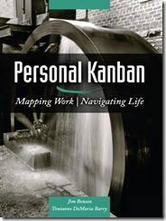
Personal Kanban
Personal Kanban: Kanban applied to one person.
Apply Kanban principles to your life.
Fully adaptable.
Personal Kanban: Commercial book/website.
Useful, but not necessary.
http://www.personalkanban.com

Slide 43
Kanban tools
Wall, whiteboard, blackboard: Basic approach.
Software, cloud-based:
Trello, JIRA, GitHub Issues.
Many more.
I use Trello (browser, Android, iPhone, iPad).
Can add, view, update, anytime, anywhere.
Different boards for different contexts
Effective when people are split on multiple projects

Slide 44
Importance of “In Progress” concept for you
Junior community members:
Less control over tasks.
Given by supervisor.
In Progress column: Protects you.
If asked to take on another task, respond:
Is this important enough to
back-burner a, b, and c?
become less efficient?
Sometimes it is.

Slide 45

Building on Kanban
A-Team Tools: A collection of resources for understanding and applying lightweight agile practices to your scientific SW project
Especially useful for
Small teams
Teams of teams
Teams that frequently have members come and go
https://betterscientificsoftware.github.io/A-Team-Tools/

Slide 46
Samples from Collegeville Org: Kanban Board

Slide 47
Kanban in GitHub
GitHub supports basic Agile development workflows
Filing issues
@mention
Kanban board
Projects
GitHub lacks more advanced features
Dependencies between issues
You can reference one issue in another
Advanced notification schemes
Custom fields
You can create custom labels
Jira: Full-featured issue tracker.

Slide 48
My Experience with Kanban
Can be applied to any existing project immediately, partially:
Start collecting and organizing your tasks in columns.
GitHub, GitLab, Jira all support column layout of work tasks.
Instant improvement: The dashboard alone has immediate value.
Capture entire context of a task (required input, due date) in one place.
I use this approach to organize ECP Software Technology leadership work.
Make “In Progress” column empty before vacation.
Complete or delegate task.
Run meeting using shared dashboard.
When you fall out of the habit of using your board, start again.

Slide 49
Questions, comments?

Slide 50
Planning
Plans are worthless, but planning is everything.
- Dwight D. Eisenhower

Slide 51
Code-and-Fix Development Approach
100 %
Visible Progress (Writing code,
computing results)
Recoding and Porting to new Platforms
Percent
Effort
Planning
0 %
Time
Adapted from Software Project Survival Guide, Steve McConnell
Early Effort
Profile
Midlife Effort
Profile
Endlife Effort
Profile

Slide 52
Simple Planned Development Approach
100 %
Recoding and Porting to new Platforms
Visible Progress
(Writing code,
computing results)
Percent
Effort
Planning
0 %
Time
Early Effort
Profile
Midlife Effort
Profile
Ongoing Effort
Profile

Slide 53
Stories
Gathering and refining requirements

Slide 54
User Stories: “As a < >, I want < >, so that < >.”
User Stories: Lightweight method for defining, refining, prioritizing requirements.
Resource: Many sources. We list just a few:
User Stories – Atlassian: Makers of Confluence, Jira.
User Stories: An Agile Introduction: Agile Modeling
User Stories: Commercial site (Mountain Goat Software), but good basics.
How to write good user stories: A YouTube video from CA Technologies that provides some tips for useful stories.
Getting Started with Agile : Epics, Features, and User Stories - YouTube: A nice overview of agile requirements.
“As a, I want, So that” Considered Harmful: Does not dismiss value of user stories, reminds the reader that the format is not magic, and that variations can be useful for encoding requirements more effectively. More generally, Crisp's Blog (note: many articles are in Swedish) is a good resource for topics in modern software development.
Replacing the User Story with the Job Story: “When < >, I want to < >, so I can < >.”

Slide 55
Phase 1: Generate Stories
Brainstorm: Don’t worry about phrasing, size, details.
Collect in a table (shared document is best):
# | Title | Reported by | Story | Stakeholders | Resources (URLs)
1 |  |  | As < >, I want < >, so that < >.
 |  |  | When < >, I want to < >, so I can < >.

Slide 56
Phase 2: Scope, refine, prioritize
Discussion: Discuss each story for scope, understanding and right-sizing.
Out of scope: Identify stories that are out of scope for our class.
Clarify and right-size: Clarify the story, perhaps split into more than one, or combine with another, such that the stories are roughly the same "size" and scope.
Prioritization and choosing: Order top (not all) stories based on importance and ability to execute.

Slide 57
Stories Useful in Many Settings
Tool selection: Select team IDE - Cloud9 AWS – GoogleDocs of IDEs.
Team policy: Behaviors, practices expected from my team.
Group reorg: What each team member needs - Guided ECP ST reorg.

Slide 58
Documenting Design
Fix mistakes before you write the software.

Slide 59
Planning tools: Use what you know
Latex Planning Document
Commit log messages
KokkosKernels - add design note for discussion.
This design note is very informal and working note for discussion.
…
For typeset, "make"
KokkosKernels - add more algorithm variants.
In this algorithm design, I have a few assumptions.
…
KokkosKernels: Micro & Batched BLAS Design Document
6 weeks: Design by LaTeX.
Review by diverse experts.
Significant design changes: In text only.
2 weeks: Write code.
Message: Use the tools you know.
Courtesy: KokkosKernels Development Team

Slide 60
How To Get Better
“Use iteration and incrementation only for projects you want to succeed.”
Adaption of Martin Fowler quote

Slide 61
Basic Strategy for Introducing Things We Will Talk About
Identify, analyze, prototype, test, revise, deploy. Repeat.
Realistic: There is a cost.
Startup: Overhead
Payoff: Best if soon, clear
Working model:
Reserve acceptable time/effort for improvement.
Improve how you do your work on the way to getting it done.
Repeat.
Old Process
New Process
Cost
Start
Progress
Finish

Slide 62
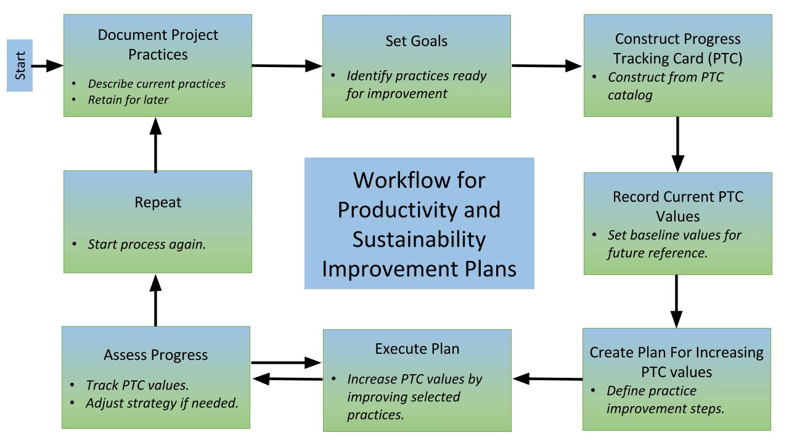
Productivity & Sustainability Improvement Planning (PSIP)
https://betterscientificsoftware.github.io/PSIP-Tools/

Slide 63
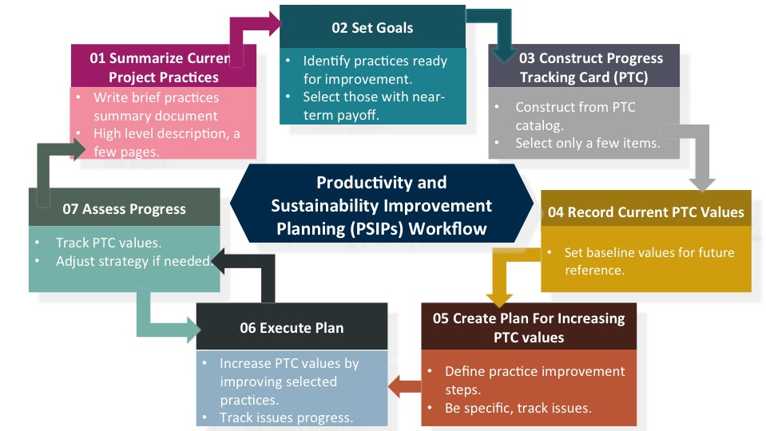
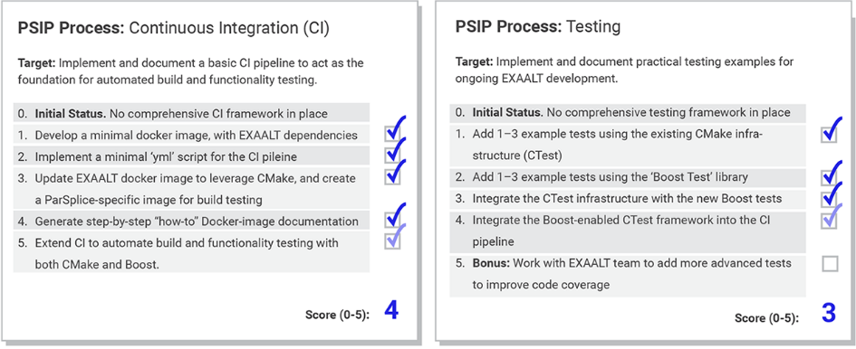
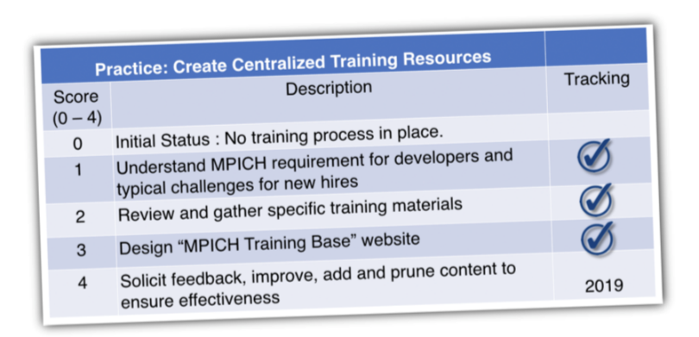
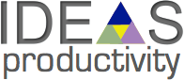
Productivity and Sustainability Improvement Planning (PSIP) Examples: EXAALT & MPICH
PSIP workflow helps a team create user stories, identify areas for improvement, select a specific area and topic for a single improvement cycle, and then develop those improvements with specific metrics for success.
EXAALT PSIP: Continuous integration (CI) testing
BSSw blog article: Adopting Continuous Integration for Long Timescale Materials Simulation, Rick Zamora (Sept 2018)
MPICH PSIP: Onboarding new team members

Slide 64
Personal Expectations
Calling out the best in team members

Slide 65

Final Thoughts: Commitment to Quality
Canadian engineers' oath (taken from Rudyard Kipling):
My Time I will not refuse;
my Thought I will not grudge;
my Care I will not deny
toward the honour, use,
stability and perfection of
any works to which I may be
called to set my hand.
https://www.egbc.ca/Member-Programs/Students/Iron-Ring

Slide 66
A Few Concrete Recommendations
Show me the person making the most commits on an undisciplined software project and I will show you the person who is injecting the most technical debt.
GitHub stats: Easy to find who made the most commits.
Some people: Pride in their high ranking.
Instead, be the person who ranks high in these ways:
Writes up requirements, analysis and design, even if simple.
Writes good GitHub issues, tracks their progress to completion.
Comments on, tests and accepts pull requests.
Provide good wiki, gh-pages content, responses to user issues.

Slide 67
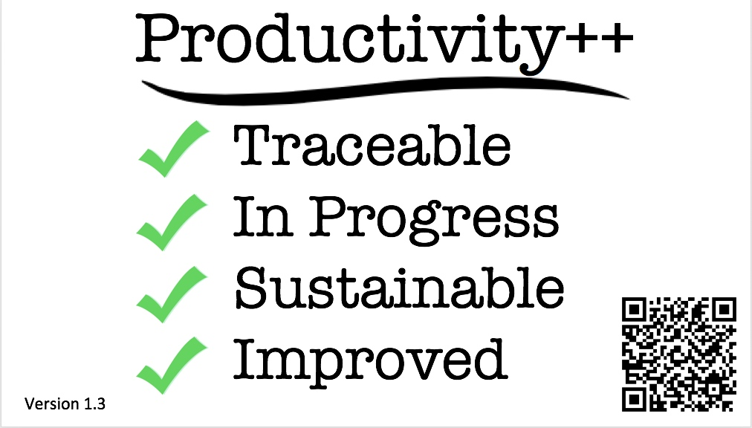
(Personal) Productivity++ Initiative Ask: Is My Work _______ ?
https://github.com/trilinos/Trilinos/wiki/Productivity---Initiative

Slide 68
Wrap Up
Better software engineering needed: Makes transparency & reproducibility affordable.
Barely-sufficient SW engineering is turnkey with GitHub & related platforms.
Agile for Scientific Software can make sense:
Careful introduction of formality, continued adoption of tools and platforms.
Lightweight, structured planning seems highly impactful:
Kanban, User/Job stories, basic design document.
Iteration and incrementation effective for continual improvement:
PSIP or similar approach can be used.
https://betterscientificsoftware.github.io/PSIP-Tools/
Calling out the best in team members:
Articulate the mission, inspire members to individual improvement.

Slide 69
Questions, comments?
Thank You.

